Slide 1


Inter IIT Tech Meet 8.0
Models and Robotics Section (MaRS) IIT-R
presents
TERRACE FARMING BOT

Slide 2
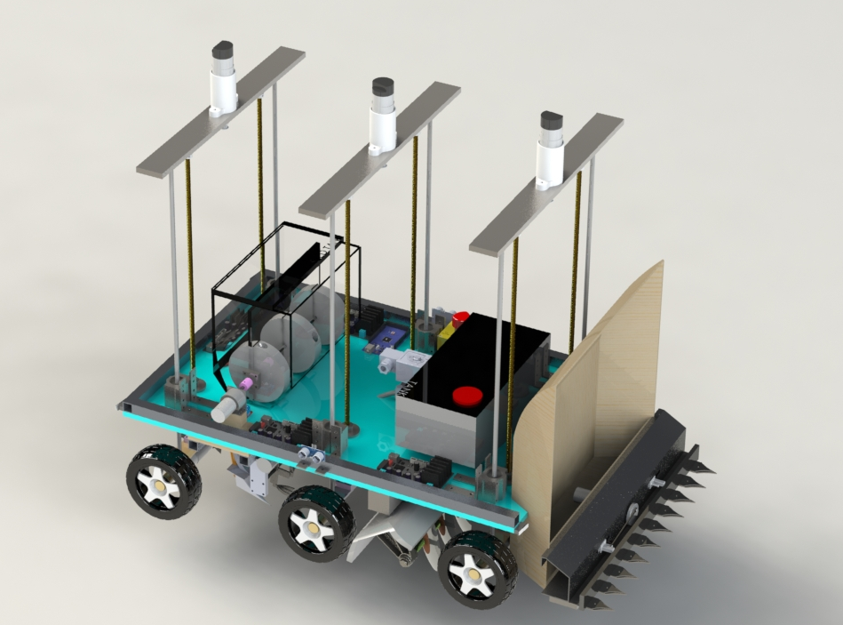
Proposed Design

Slide 3
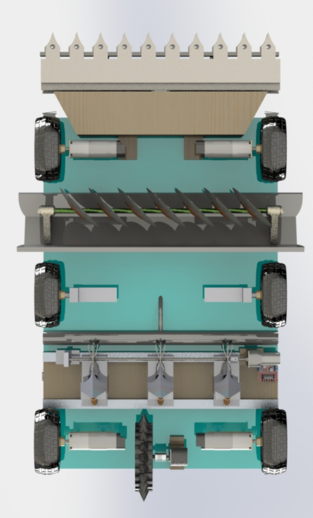
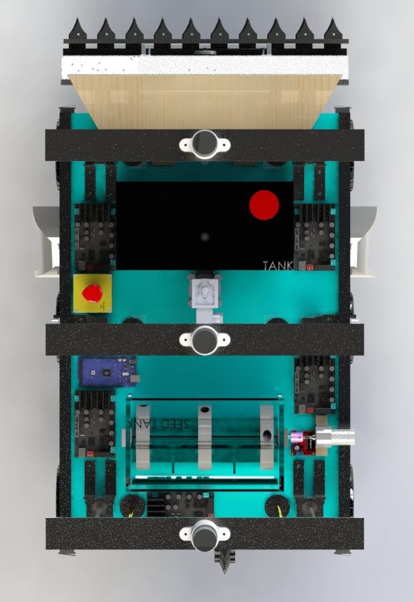
Top view
Bottom view

Slide 4
Mechanical aspects
As per the proposed mechanical design, the Terrain Farming Robot has been divided into following modules.
Traversing
Climbing
Ploughing
Seeding
Watering
Harvesting
Weed Detection

Slide 5
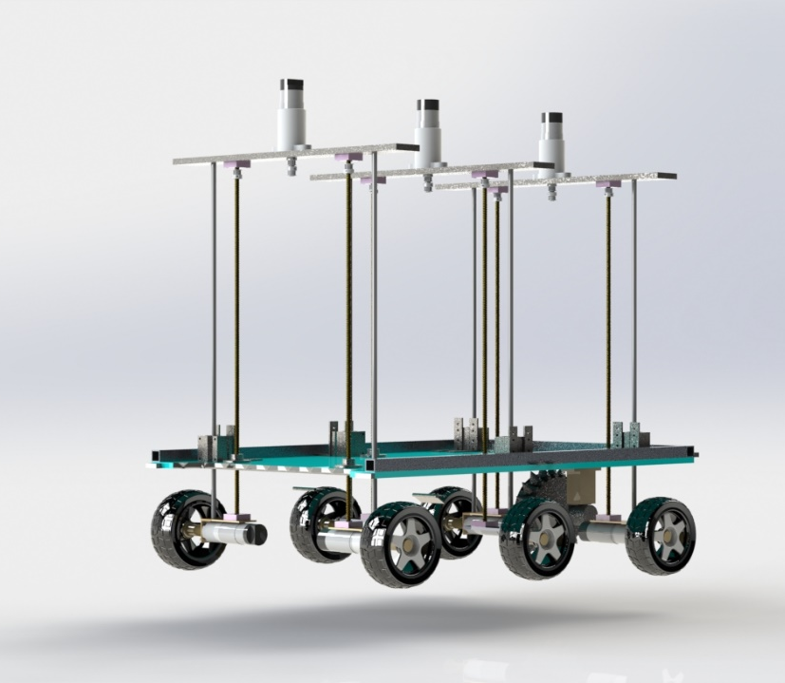
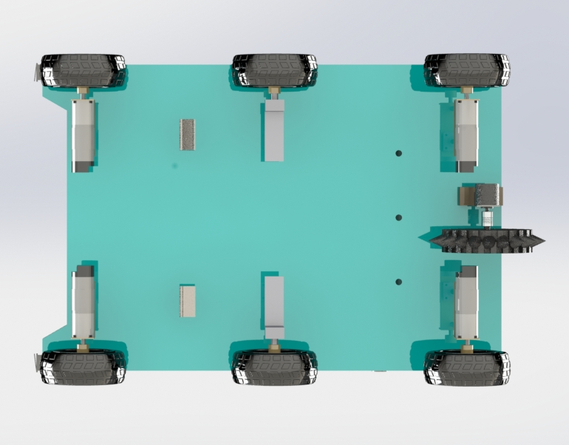
Traversing
The bot traverses on the concept of a four wheel differential chassis, along with two central idler wheels for extra stability while climbing the steps and traversing on uneven surfaces.
A rotary encoder is attached on a spiked free wheel to calculate the readings without any slipping errors.

Slide 6
Climbing
Climbing of the bot is the actuation to be taken most care because it should be efficient in terms of power consumption and strong enough to take the load of the whole bot.
For this, a mechanism is proposed with the help of 6 lead screws operated by 3 planetary geared DC motors.
An algorithm involving a series of steps is followed by the bot which is explained in next slide.

Slide 7
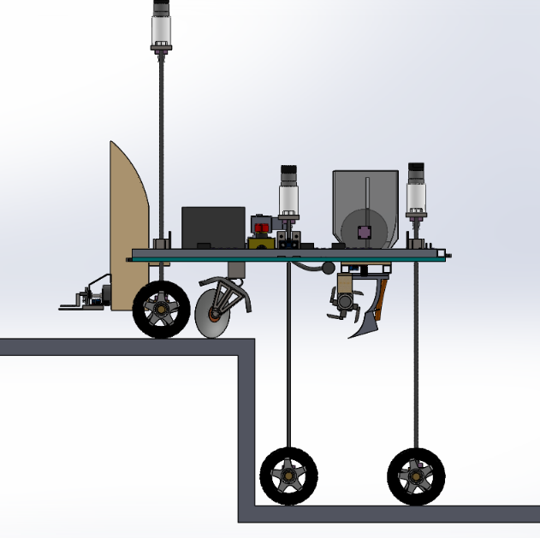
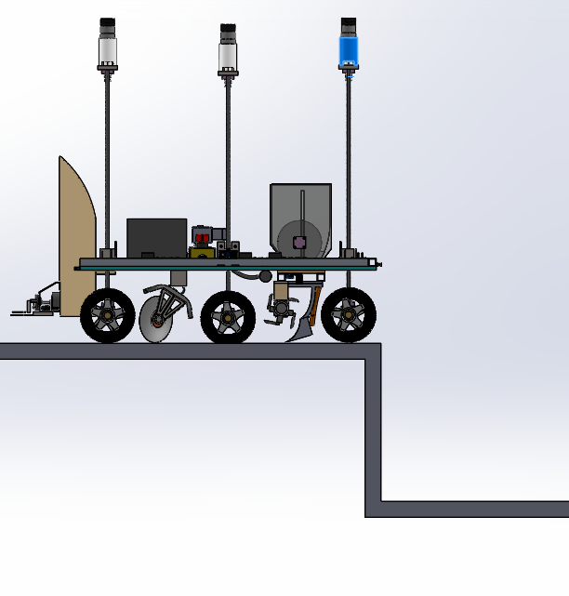
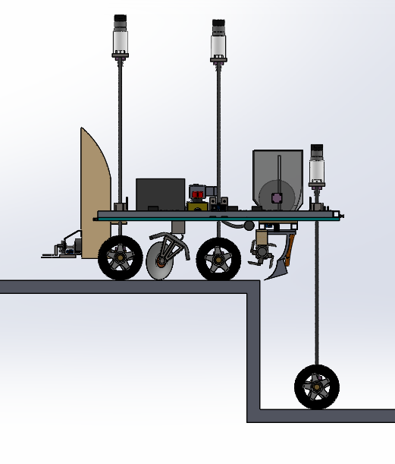
In the second step, the Middle Wheels will be pulled back up and the bot will move forward to rest on the stair on front and middle wheels.
In the first step, the lead screws of Middle and Back-wheel assemblies will be actuated and the chassis will be lifted up to 45cm above the ground. Then the bot will move forward until the front wheels rest above the stair.
In the last step, the back wheels will be pulled up and the bot will have climbed up the stair.

Slide 8
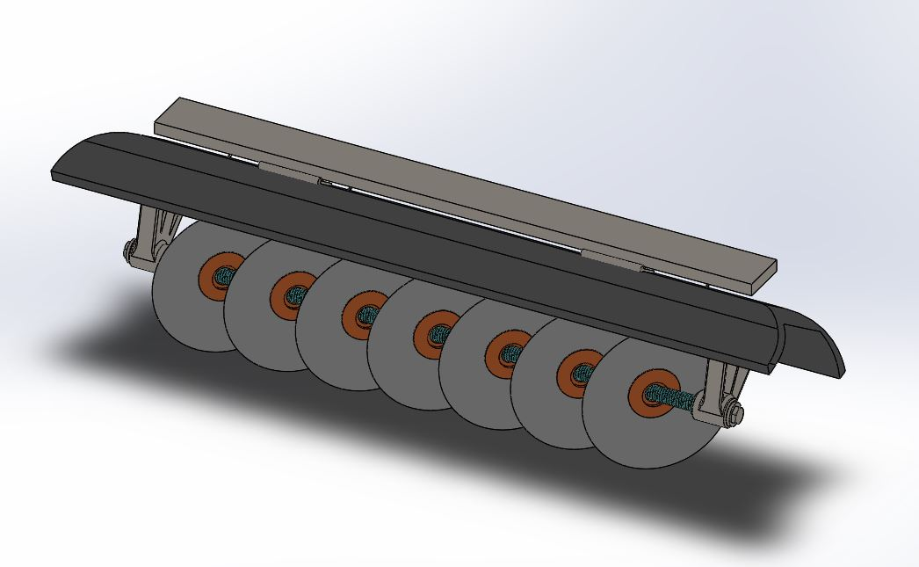
Ploughing
Disc ploughs are the best option available as ploughs because they require less power and can easily work on stony lands too.
We used a concave disk which generally maintains a certain angle (15-25 degrees) with respect to the vertical, known as the tilt angle. This helps in increasing the depth or maintaining a particular depth which we want.
The discs also maintain an angle of 40-45 degrees with the direction of travel which helps it in rotation and opening of the soil by scooping it out simultaneously.

Slide 9
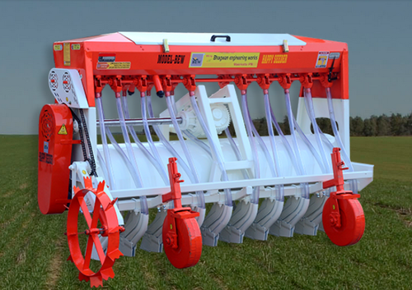
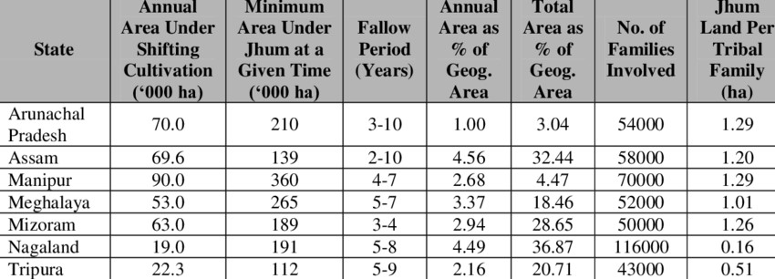
Seeding (Happy Seeder)
Happy Seeder is gaining popularity these days among farmers which involves technology instead of using the polluting method of crop stubble burning in the sowing seasons.
The Happy Seeder cuts and lifts paddy/rice straw, sows wheat and other crop seeds into the bare soil and deposits the straw over the sown area as mulch.
Prevents Shifting Cultivation.
Environment friendly technology.
Improved soil health.
Saves Fuel & Time.
Sows wheat in the residual moisture.

Slide 10
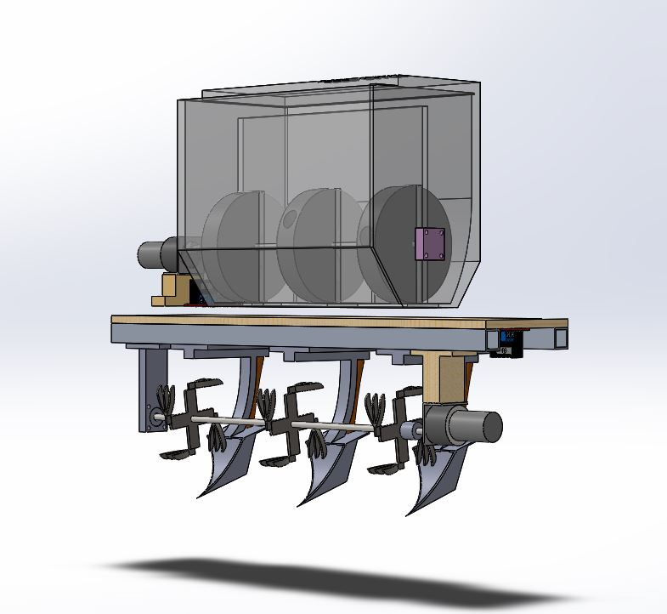
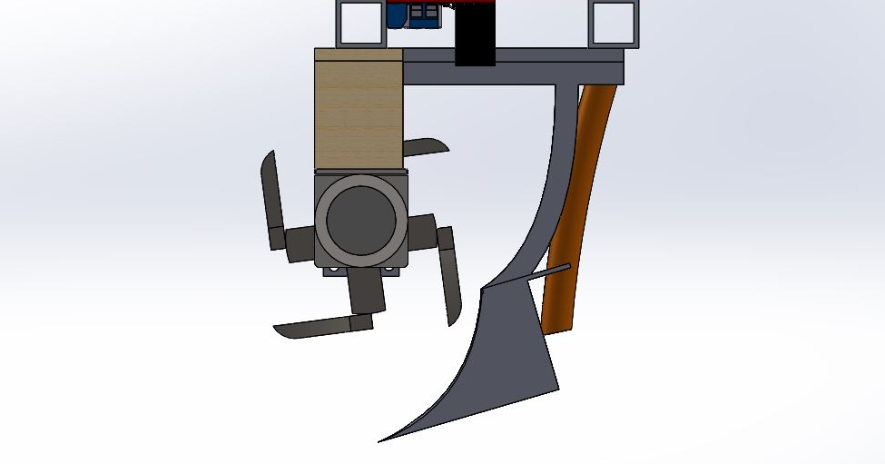
In our proposed design, we have used the Happy Seeder and cultivators along with outlet pipes at their back so they easily drop off seeds in the tillage so formed.
For dropping the seeds, a seed tank is attached on the bot that is run by a Johnson’s DC motor which periodically directs the seeds to the outlet pipes.
Seed Tank
DC Motor
Cutting Blades
Outlet pipes
Cutting Blades
Cultivators
Cultivator

Slide 11
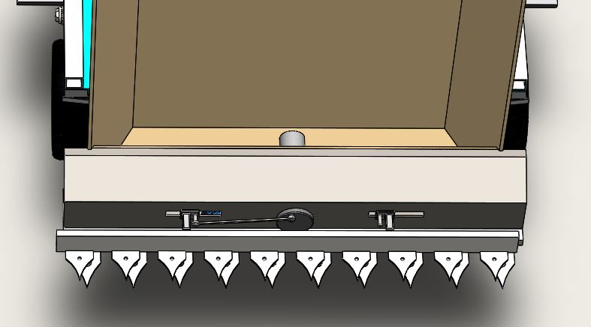
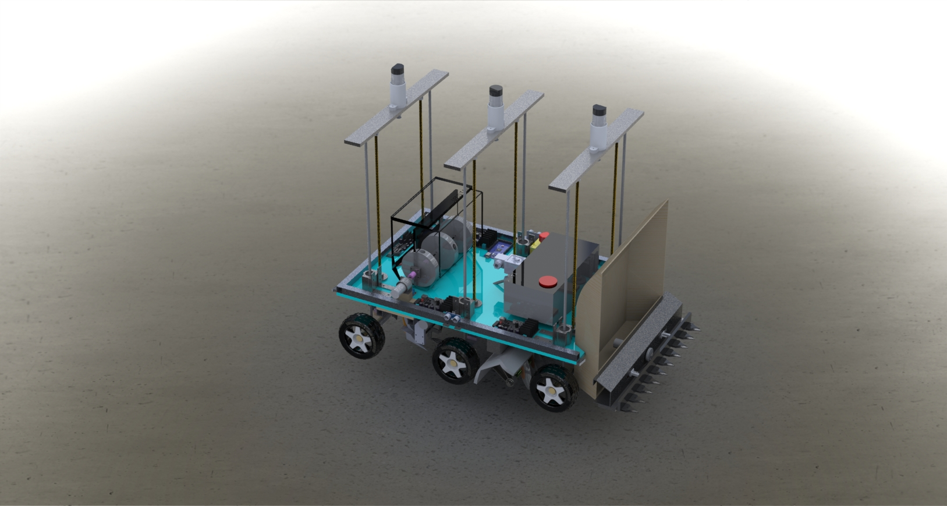
Harvesting
A detachable light-weight harvester actuated with a DC motor is used which is having a mini-storage tank facility.
Cutting blades have been designed in such a manner so that the farmers can easily harvest the crops from the desired height from the soil.
Storage
Cutting Blades
Harvester

Slide 12
Electronic Aspects
Advanced
Sensors: Installed with advanced sensors like moisture, humidity, temperature etc. to get the data inputs.
IOT enabled: Display sensor data on a web page. The bot can be controlled as per user discretion.
Weed detection: The bot is capable of detecting weed and perform the required action to eliminate it.
Alert System: A centralized alert system governs the bot. It can alert the user in case of:-
Shortage of seeds
Low power
Internal damage
Solar powered: The bot can be customized to run on solar powered panels.

Slide 13
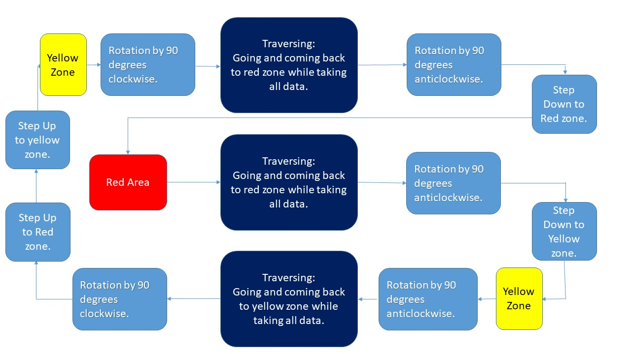
Task flow for bot navigation

Slide 14
Traversing
Traversing occurs with the help of ultrasonic sensors. Which is used to maintain a constant distance from the wall.
After starting, the bot will stop successively after a fixed distance and take readings of various sensors and do watering.
Ploughing will occur automatically as the bot moves.
After detecting end bot will take 180 degree turn clockwise and move back to the red or yellow region.
After detecting red or yellow region, bot will do the required action.

Slide 15
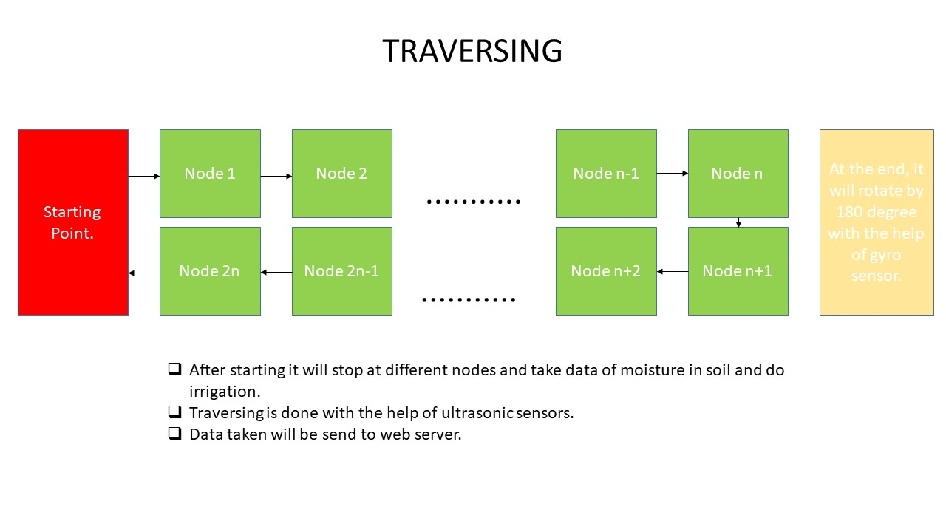

Slide 16
Sensors used
ULTRASONIC SENSOR: 5 such sensors are used. Mainly used to maintain constant distance from wall while traversing.
COLOR SENSOR: 2 such sensors are used to detect the zones i.e. yellow zone and red zone.
SOIL MOISTURE SENSOR: 1 moisture sensor is used to take data inputs from the cultivated land.

Slide 17
Sensors used
TEMPERATURE SENSOR: 1 temperature sensor is used to get the temperature data from the field.
ROTARY ENCODER: 1 rotary encoder is used to keep track of the displacement of the bot. Rest of the DC motors used have inbuilt encoders.
MPU 9250 : 1 such sensor is used. It contains gyroscope, accelerometer and magnetometer. It is used to maintain the orientation of the bot.

Slide 18
Working of the IOT
Input data from different sensors (humidity, temperature, moisture etc. ) will be registered by the Arduino AT Mega micro controller.
The input data from the sensors will be sent to the esp8266 NODE MCU through UART communication.
The files received by the esp8266 NODE MCU through the serial monitor will be then sent to the database wirelessly.
The files in the database will be sorted according to the nodes present on the fields. (nodes are the points on the actual land where the bot will take the sensor readings)
The readings will be rendered to the web page depending upon the choice of the node the farmer wants to analyze.

Slide 19
Simplified flow chart
Receives data of different sensors from micro controller wirelessly
Stores the data in database sorted according to the nodes
A web-page displays the cultivated land divided into different nodes.
Farmer clicks on the node whose data is to be analyzed.
Data of the particular node is rendered to the website and displayed.

Slide 20
Wireless data transfer to Database
A set of code running on the NODE MCU will create a local server.
A python script will be running in the background and will be connected to the same server as created by the NODE MCU.
This python script will run on the computer where the database is to be created.
The data transfer from the NODE MCU to the database will take place through the common local server through which they are connected.
ESP_MICRO.h is an important micro header file for the NODE MCU which is essentially required for such data transfer.

Slide 21
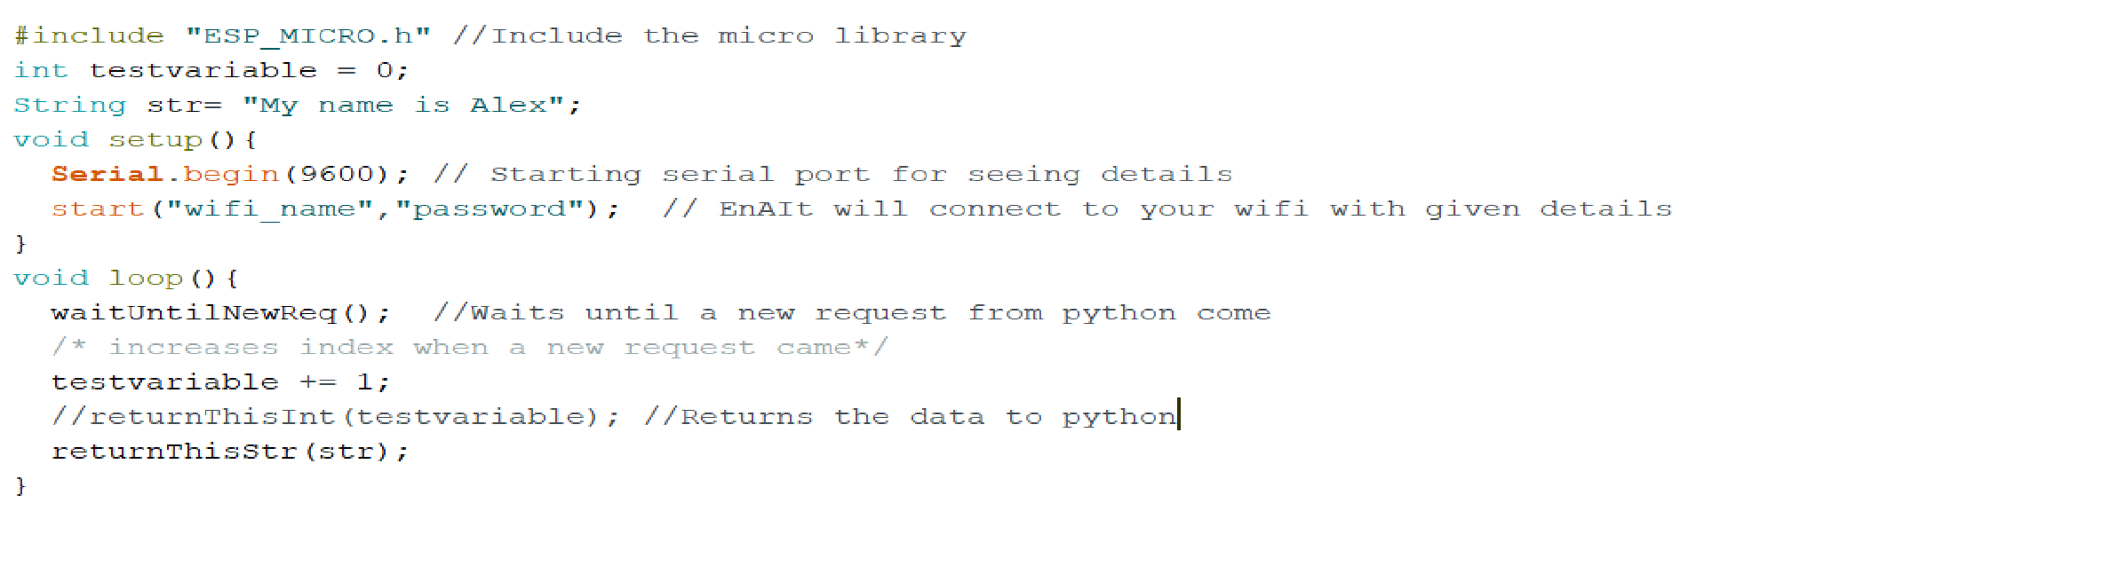
Sample esp8266 code
Following code will run on the esp8266 and will be responsible for creating the local server and transfer of data to the python script.

Slide 22
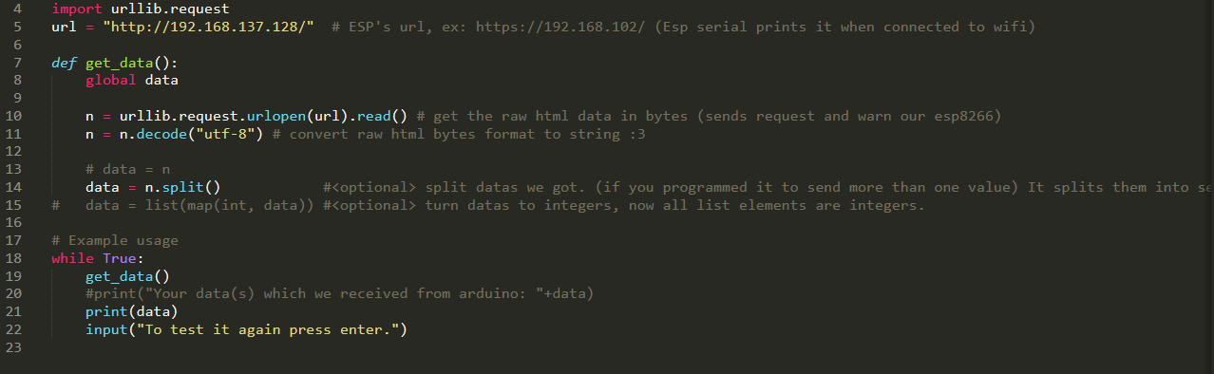
Sample Python Script
The following is a sample python code which will run on the computer where the database is located. The code will receive data from the esp8266 through the local server as shown.

Slide 23
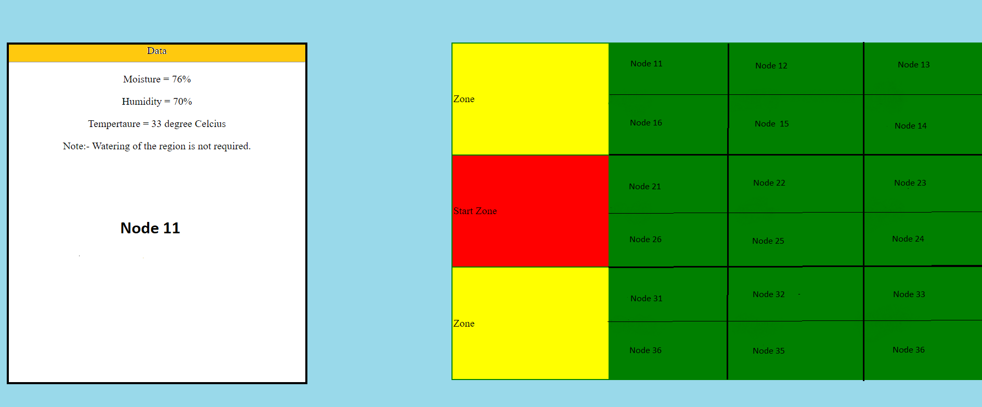
The Web Page
Below is the snapshot of the preliminary web page that will be accessed by the user.

Slide 24
Working
The right hand table in the web page is a 2 dimensional replica of the land under cultivation. In our case it is the arena for the problem statement.
The table is responsive and will respond to the click of the user.
Each step is divided into different nodes. It is the region where the Agri-tech bot will take the readings from the sensors.
The user has to click on the node whose readings he wants to analyze.
The data of the particular node will be displayed in the box present on the left hand side of the web page.
The data from the database will be rendered to the website using flask. A note/message can be delivered regarding what can be expected of the readings.

Slide 25
Weed Removal: Importance
Reduce the yield and quality of rice by competing for nutrients, water and sunlight
Weeds intensify the pest and disease problem by serving as alternate
host
Reduce the efficiency of harvesting
Reduce the land value
Problems of water contamination
Upland direct seeded | 35-45 % reduction in yield
Direct seeded on puddle land | 20-25% reduction in yield
Transplanted rice | 10-15% reduction in yield

Slide 26
Automated weed detection
Removal of weed is a very labor intensive and time consuming process and thus requires to be automated.
A high resolution camera is mounted on the bot to capture live feed video.
The detection tool uses machine learning procedure based on support vector machines and blob analysis for effective classification of weed.
Training of the model is done based on 3 scenarios:-
Maximum crop sample
Maximum weed sample
Marginal weed and crop sample
The trained module is expected to achieve a success percentage of 59-95% to detect the weed.

Slide 27
Sample detection
Maximum weed sample
Marginal weed and crop
Model successfully detecting weed in the presence of maximum weed in the video frame.
Model successfully detecting weed in the presence of crop.

Slide 28
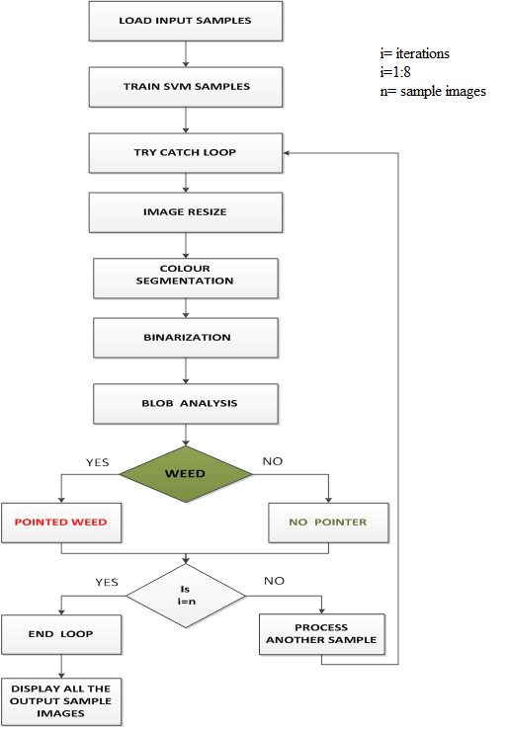
Task Flow

Slide 29
Thanks…

